Slide 1
Pattern Recognition
Project 1
Lukas Drexler, Leiv van Hollande, Reza xxxxx, Mark Springer, Maximilian Thiessen

Slide 2

1. Task

Slide 3
2. Task

Slide 4
3. Task

Slide 5
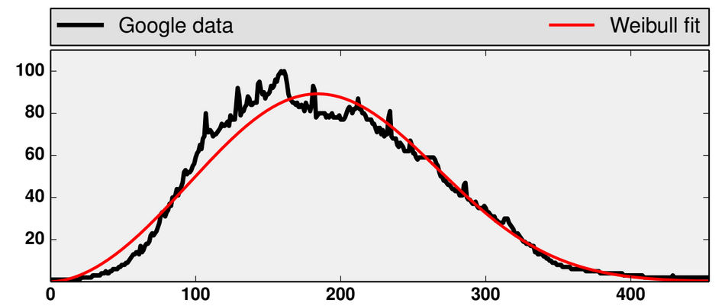
3. Task
Fit weibull distribution
to given data
Estimate parameters
and by
maximum likelihood

Slide 6
3. Task – Using histogram
Use only the histogram data and not the whole
Small example:
is the absolute frequency
is the set of all possible values

Slide 7
3. Task – Using histogram
Sum over D:
Sum over function of D:

Slide 8
3. Task – Newton Method
Applied the method
from the task description
Tried more steps

Slide 9
Task 3 – ODE Method

Slide 10
4. Task

Slide 11
Exercise 5

